Slide 1
Civil Engineering Applications of Ground Penetrating Radar (proposal oc-2012-1-12576)
Proposer:
Lara Pajewski
«Roma Tre» University, Rome, Italy
Transport and Urban Development Domain
Brussels, 12 September 2012

Slide 2
Outline
Main Objective and History of the Proposal
Background and Reasons for the Action
Objectives, Impact and Benefits
Scientific Programme
Organisation and Timetable
Participants and Economic Dimension
Dissemination Plan
Involvement of Early-Stage Researchers and Gender Balance
Conclusions
2
43

Slide 3
Main Objective and History of the Proposal
3
43

Slide 4
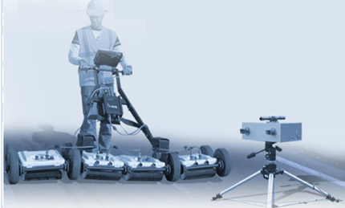
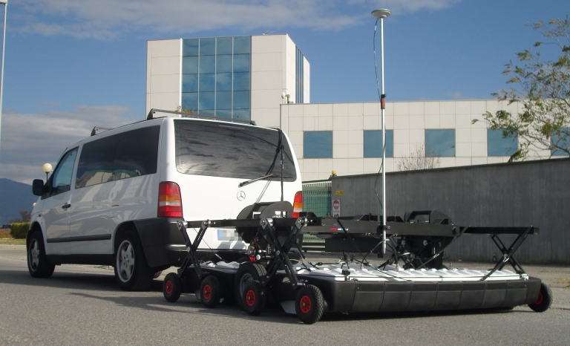
Main Objective
Exchange and increase scientific-technical knowledge and experience of Ground Penetrating Radar (GPR) techniques in Civil Engineering (CE), simultaneously promoting throughout Europe the effective use of this safe and non-destructive technique.
The Action will establish active links between universities, research institutes, companies and end users working in this field, fostering and accelerating its long-term development in Europe.
4
43
Notes:
This Action focuses on the exchange and increase of scientific-technical knowledge and experience of Ground Penetrating Radar (GPR) techniques in Civil Engineering (CE), at the same time promoting a wider and effective use of this non invasive and safe technique for the monitoring of infrastructures and structures. The Action will therefore address real current problems as well as research opportunities.
The project has already received the interest of key end users and excellent EU Institutions from 15 COST Countries and also from Australia and from 6 States in US. It will be developed within the frame of a unique approach based on the integrated contribution of University researchers, electronic and civil engineers, software developers, geophysics experts, Non-Destructive Testing equipment designers and producers, and end users from private companies and public agencies.

Slide 5
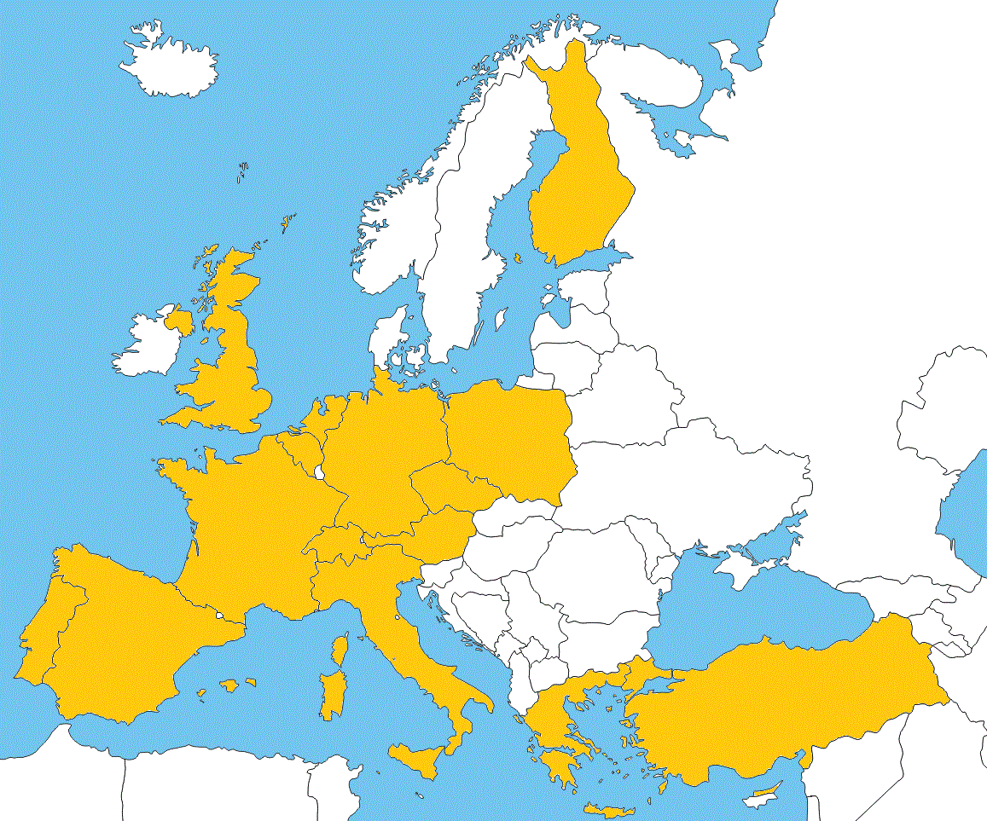
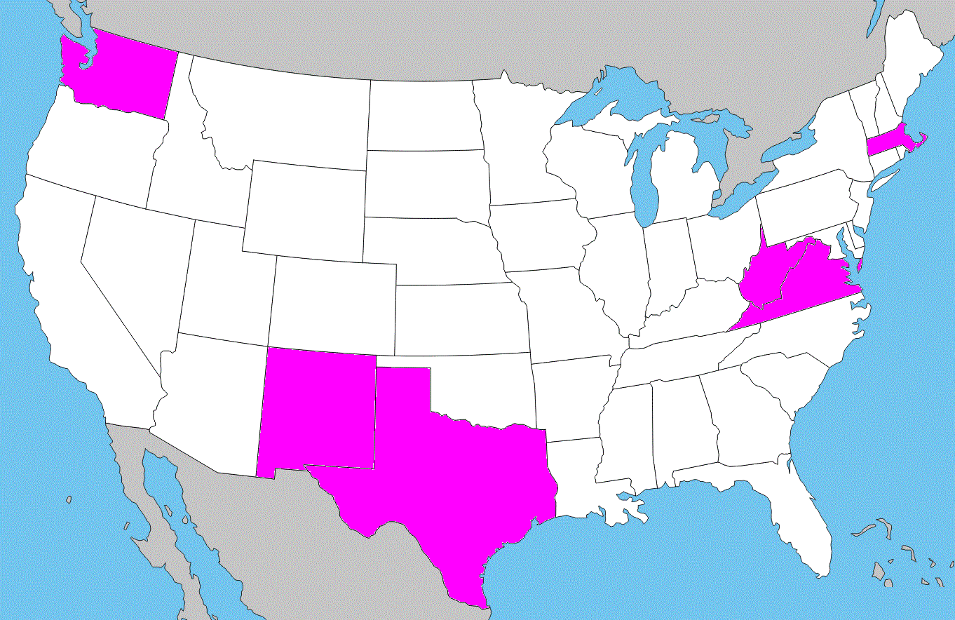
History
Initial idea: Paris, EuMW 2010
1st pre-proposal: March 2011
2° pre-proposal: Sept. 2011
3rd pre-proposal: March 2012
Discussed in Vienna,
EGU-GA 2011 and 2012
→ this full proposal!
Full proposal supported by
15 COST Countries, US, Australia
5
43
Notes:
The initial idea of presenting a proposal for a new COST Action on CE application of GPR was born during the European Microwave Week held in Paris in 2010.
I participated to this conference thanks to a COST Conference Grant for early-stage researchers (I was a participant of the COST Action MP0702). Several participants of our Action already know COST mechanism, since they were involved in past Actions as Chairman, Management Committee members or simple participants.

Slide 6
Background and Reasons for the Action
6
43

Slide 7
Background
GPR: safe, effective, non-destructive and non-invasive imaging technique, providing high resolution images of subsurface and structures through wide-band electromagnetic (EM) waves.
Quick and inexpensive in comparison to other investigation methods.
Penetration and resolution depend on the GPR transmitting frequency, and on the electrical properties of surveyed material and targets.
7
43
Notes:
It is quick and inexpensive in comparison to other investigation methods and is capable of probing down to a few tens of meters, depending on the system characteristics and on ground conditions. Obtaining adequate penetration with good resolution is not easy.

Slide 8
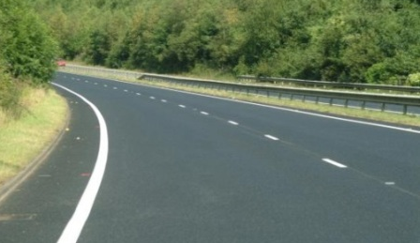
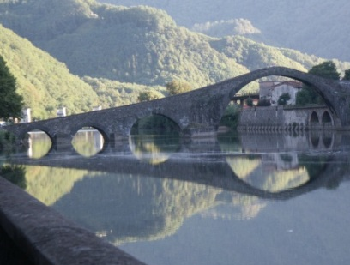
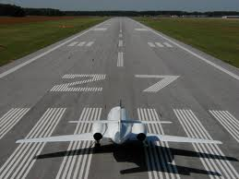
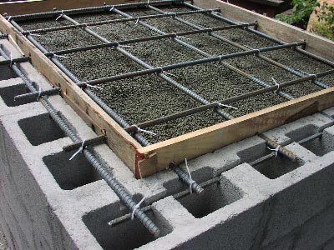
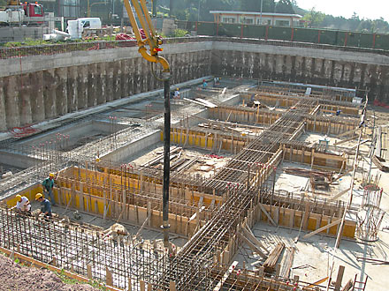
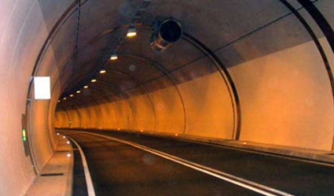
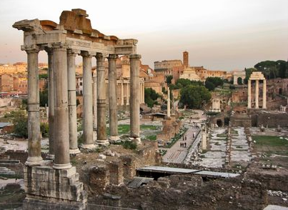
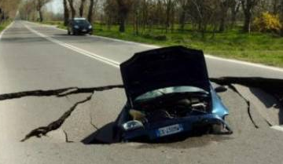
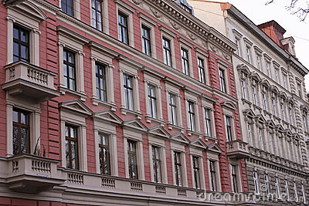
Background
CE Applications: inspection of composite structures and diagnostics affecting the whole life-cycle of CE works.
Data Processing & EM Solver: preliminary characterization of scenarios, measured-data interpretation, identification of signatures generated by uncommon/multiple targets.
Standardization: few International Standards (ASTM); EN302/066 code (ETSI); RTTE directive 1999/5/EC; ECC decision DEC/(06)08;
inhomogeneous recommendations for GPR effective use in different Countries; different levels of knowledge, awareness and experience.
8
43
Notes:
The GPR field has seen great advancements over the past 15 years. Its progress spans aspects of geophysics, technology, electromagnetics, data processing and a wide ranging of scientific and engineering applications.
For what strictly concerns CE, there are several possible applications of GPR affecting the whole life-cycle of CE works…some of them suggested by images in this slide…. It can be employed for the surveying of roads, highway pavements and airport runways, bridges, tunnels and for detecting underground cavities and voids, as well as for the inspection of buildings and groundwater/pollution evaluation. It can also be used for utility sensing. Gas, water, electricity, telephone and cable utilities can be localized. Moreover, GPR can be used to perform detailed inspection of reinforced concrete and to locate steel reinforcing bars and pre/post-tensioned stressing ducts. An analysis of geological structures can be made with GPR, for the mapping of soil, rock or fill layers in geotechnical investigations and for foundation design.

Slide 9
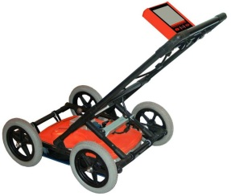
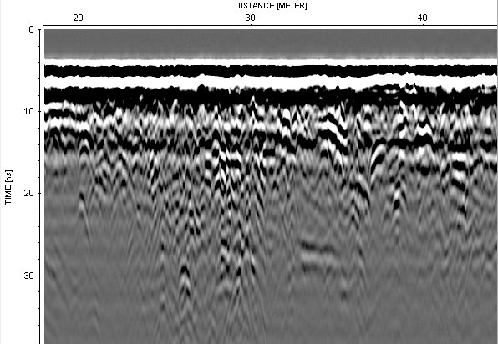
Background
Three areas have to be addressed in order to promote the GPR use in CE
Advancement of GPR system, increase of sensitivity to enable usability in a wider range of conditions.
Improvement of data processing/EM algorithms to ease the interpretation of results by un-experienced operators.
Development of standards/guidelines and training of end users, to increase the awareness of operators.
9
43

Slide 10
Background
Hundreds of research papers, special issues on Journals and conference Proceedings devoted to GPR theory, technology and its application in CE.
GPR is of interest for…
…and for several European Technology Platforms: European Construction Technology Platform, Advanced Engineering Materials and Technologies, Industrial Safety Technology Platform, European Road Transport Research Advisory Council, European Space Technology Platform.
International events where high-level discussions and exchange of experience related to GPR use in CE take place: “International Conference on GPR”, “International Workshop on Advanced GPR”, EGU GA, EuCAP, URSI symposia, …
10
43
Notes:
The European Geophysics Union (EGU) and the Institute of Electrical and Electronics Engineers (IEEE) are interested in GPR topics. The European Association of Geoscientists and Engineers (EAGE) has a Division devoted to Near Surface Geoscience. The European GPR Association (EuroGPR) promotes GPR use, involving users and manufacturers of GPR equipment. The Forum of European National Highway Research Laboratories (FEHRL) is engaged in road engineering research topics and is interested in GPR road monitoring techniques.
And, as other noninvasive diagnostic procedures, GPR is of interest for several European Technology Platforms, as the European Construction Technology Platform (ECTP), the Advanced Engineering Materials and Technologies (EuMAT), the Industrial Safety Technology Platform, the European Road Transport Research Advisory Council (ERTRAC) and the European Space Technology Platform (ESTP).

Slide 11
Reasons for the Action
Requirement for an European network on CE applications of GPR deeply felt!
Strengthening of European excellence in the scientific-technological fields concerning the success of the GPR technique.
Wider application, all over Europe, of the safe and non-destructive GPR technique to monitoring of structures and infrastructures.
Integration and coordination of local initiatives within Europe; sharing of scientific, technical, economic and human resources, avoiding fragmentation of research.
Among possible network structures, a COST Action is the most suitable:
wider in scope than a thematic network implemented through the FP;
participation of different groups from a large number of Countries;
additional partners can always join the Action during its life-time;
coordination and financial support for meetings, workshops, STSMs, TSs, mobility
of early-career EU researchers, promotion and dissemination;
research activities supported by other institutions, agencies and companies.
11
43
Notes:
The best way to put together different specific projects and to structure and shape the way to the research carried out on GPR, and on its application to CE tasks, is through a network.
…
The Action will largely profit from the benefits that the COST Programme uniquely offers.
…
the Action does not require a large amount of money to support a limited number of national delegates participating in meetings, and to support a program of STSMs and TS, while the specific research activities of the participating groups are supported in each country by other institutions, agencies and companies

Slide 12
Objectives, Impact and Benefits
12
43

Slide 13
Objectives
Highlight problems, merits and limits of current GPR systems in CE applications.
Design, realization and optimization of innovative GPR equipment.
Develop innovative protocols and guidelines for an effective GPR use in CE tasks → published in a handbook and constitute a basis for EU Standards.
Develop EM scattering & data-processing methods → novel freeware tool for shape-reconstruction and estimation of geophysical parameters.
Comparison with GPR technology and methodology used in different applications, and with other NDT techniques for CE applications.
Promotion of a more widespread, advanced and effective use of GPR in CE.
High-level modular training program.
13
43
Notes:
Safety, economic and financial criteria will be integrated within the protocols
…the localization of buried objects…
…such as rover-based planetary exploration, archaeological prospecting and cultural heritage diagnostics, detection of explosive remnants of war and humanitarian demining, geology and geophysics, agriculture, environment research, forensics and security….
…such as ultrasonic, radiographic, liquid-penetrant, magnetic-particle, acoustic-emission and eddy-current testing…

Slide 14
Objectives will be achieved by…
Investigating novel theoretical paradigms – under a multidisciplinary approach.
Defining, comparing and testing procedures for advanced GPR use in CE.
Developing new EM and data-processing approaches and related sw codes.
Designing, realizing and testing advanced prototypes.
Employing GPR in new case studies and applicative domains.
An electronic communication and information platform will be created.
Mobility of early career EU researchers will be encouraged and supported.
The Action activities will be disseminated and promoted in order to involve a growing number of participants and attract increasing interest from end users.
14
43
Notes:
Collaboration, information exchange and sharing are essential in order to make the most efficient use of research, capacity building and budgets.

Slide 15
Impact and Benefits
Innovation in the GPR field, increasing efficiency & quality of this technique
Benefits:
The Action will lead to durable international collaborations, strengthening
European scientific networking and capacity building.
scientific
technological
economical
societal
scientific
From a point of view:
Creation of an efficient interlink among EU Lab.
Increase of knowledge in basic physics.
Improvement of advanced GPR data-processing algorithms yields benefits also to other imaging techniques.
Development of new EM scattering methods has implications in acoustics, microwaves, optics, IT, clean-room monitoring, quality control of silicon wafers manufacture, scattering microscopy in biology and material science.
15
43
Notes:
…deeper understanding of interaction between EM waves, targets and environment, and of relationship between geophysical parameters and functional variables useful for CE needs

Slide 16
Impact and Benefits
technological
The impact is clear when considering the innovative GPR equipment that will be designed, fabricated and tested through the activities of this Action.
and benefits derive from the wider and more effective application of GPR that will take place thanks to the Action’s activities.
Many structures/infrastructures are affected all over Europe and throughout the world, by diffused poor condition which influences the safety of citizens. Where structural rehabilitation is ineffective or absent, or sub‑standard management planning is adopted and ineffective traditional tools are used, the cost of maintenance dramatically increases.
Societal
economical
Other areas using GPR that will take advantage of the Action:
archaeology, detection of landmines/explosive remnants of war, planetary
exploration, geology, geophysics, agriculture, environment research,
forensics and security.
16
43
Notes:
Let’s think, for example, to the safety of highways, roads and bridges, buildings and constructions.
No doubt that the results of the Action will be extended to these fields.

Slide 17
Scientific Programme
17
43

Slide 18
Scientific Programme
Most important research
tasks to be coordinated by the Action:
Study of problems, merits and limits of current GPR systems and of procedures for GPR application in CE tasks (also by comparing with GPR technology and methodology used in other fields and with other NDT techniques used in CE).
Synthesis, fabrication and optimization of innovative GPR equipment, with increased resolution and advanced dedicated software.
Definition of innovative protocols and guidelines for an effective use of GPR in various CE tasks.
Development of improved and new EM scattering methods, for fast and accurate simulation of scenarios involving buried composite structures.
Development of improved and new algorithms for processing of GPR data.
Improving the shape-reconstruction of buried structures and estimation of geophysical parameters useful for CE needs, from GPR experimental data.
18
43

Slide 19
Scientific Programme
Multidisciplinary approach: participation of civil and electronic engineers, software developers and geophysicians, from the academic world and from commercial companies manufacturing non-destructive testing equipment.
Contribution of experts from end users: will help in turning the high research context to practical problems and to strategic and actual applications.
Sharing of human and technical resources, GPR and other NDT equipment, measuring instruments, computers and software, manufacturing machinery and vehicles to set GPR prototypes and carry out validation activities.
The work plane is intended to be flexible, to ensure that groups not involved in the proposal preparation may join the Action at a later stage and that new disciplinary perspectives and activities may be included in the project.
19
43

Slide 20
Scientific Programme: Working Groups
WG1
Novel GPR Instrumentation
WG2
GPR Surveying of Pavements, Bridges, Tunnels, Buildings – Utility and Void Sensing
WG3
EM Methods for Near Field Scattering Problems – Data Processing Techniques
WG4
Different applications of GPR and other NDT technologies in CE
This scheme will be checked after its first year and will be modified according to the actual number of active participants in each WG - and the number of participants joining the Action.
20
43

Slide 21
Organisation and Timetable
21
43

Slide 22
Organisation
The organization of the Action conforms to the “Rules and Procedures for Implementing COST Actions” (document COST 4154/11).
The Action will take care of coordinating national research (SG and MC).
End-user database.
Communication system and Website.
Project Management structure:
Management Committee (MC), coordinating the Action, supervising its progress,
reporting on the progress of the Action to the COST Office
Editorial Board (EB), dealing with dissemination of Action’s activities, Action’s reports;
Technical Editor and Editorial Coordinator
STSM Manager; TS Manager
Steering Group (SG) comprising MC Chair and Vice Chair, WG Chairs and Vice Chairs,
Editorial Coordinator, STMSs and TS Managers
22
43
Notes:
The SG will implement the MC’s policy decisions and moreover it will contribute to the building of COST Action events (meetings, workshops, conferences, STMSs, Training Schools), to the dissemination of Action findings and to the managing of the Website.

Slide 23
Timetable
Events and Milestones
Other annual deriverables:
STSM Report (ii) WG Reports (iii) TS Lessons
(iv) Proceedings of Annual Conference, ESR Day, STSM Workshop
Interactive Website (fully set up at month 3, constantly updated throughout the ACTION)
23
43
Notes:
The Founding Conference will see the participation of Action’s members and will also be open to external participants. This will facilitate the starting of efficient networking between participants’ labs, help Action’s community to identify themselves and their research areas, make the Action visible to the outer world and also attract new parties to participate actively to the Action.

Slide 24
Participants and Economic Dimension
24
43

Slide 25
Participants
Universities
Research Institutes
Small and Medium Enterprises
One of the biggest GPR manufacturers
Public Agencies responsible for infrastructure management and maintenance
Other end users
The partnership covers, under a very well integrated approach, all the scientific
and technical profiles needed to tackle any possible Action risk and to reach an
excellent innovation standard.
25
43

Slide 26
COST Participants
15 COST Countries
Austria
Belgium
Czech Republic
Finland
France
Germany
Greece
Italy
The Netherlands
Poland
Portugal
Spain
Switzerland
Turkey
United Kingdom
Aalto
Edinburgh
Keele
Powys
Chatham Maritime
Bruxell
Ghent
Liege
Stevinweg
Louvain-la-Neuve
Berlin
Warsaw
Bouguenais
Paris
Strasbourg
Prague
Brno
Kielce
Cracow
Rouen
Pontevedra
Duebendorf
Lugano
Wien
Bordeaux
Arles
Genova
Toulouse
Guimarães
Barcelona
Valencia
Pisa
Rieti
Rome
Naples
Athens
Ankara
Crete
26
43

Slide 27
Non-COST Participants
Radar Portal Systems Pty Ltd (Brisbane)
University of Queensland, Department of Main Roads, Structures Division (Brisbane)
University of Mississippi, Dept. of Electrical Engineering, Mississippi, MS
Washington State Dept. of Transportation, Olympia, WA
University of Texas, Dept. of Civil and Environmental Engineering, San Antonio, TX
Hampton University, Dept. of Electrical Engineering, Hampton, VA
University of New Mexico, Civil Engineering Dept., Albuquerque, New Mexico
National Transportation Center, West Virginia University, Morgantown, WV
27
43

Slide 28
Economic Dimension
On the basis of national estimates, the economic dimension of the activities to be carried out under the Action has been estimated at 60 Million € for the total duration of the Action.
This estimate is valid under the assumption that all the Countries mentioned above but no other Countries will participate in the Action. Any departure from this will change the total cost accordingly.
The research will be carried out in and financed by the
participating Countries, while COST will provide
the necessary coordination.
28
43

Slide 29
Ongoing Projects
Current projects in the 7th EU Framework Programme involving Action’s partners:
“Smart condition monitoring and prompt NDT assessment of large concrete bridge structures”, Cambridge University, United Kingdom, Nov. 2011 – Oct. 2013
“Radiography of the past. Integrated non-destructive approaches to understand and valorize complex archeological sites”, Univ. Evora, Portugal, Apr. 2009 – Mar. 2013
“SMART RAIL: Smart Maintenance and analysis of transport infrastructure”, Univ. College Dublin, National Univ. Dublin, Ireland, 2011 – 2014
“Tomorrow's Road Infrastructure Monitoring and Management”, Staten Van-Och Trasporforkningsinstitute, Sweden, Dec. 2011 – Nov. 2014
“NEw Technologies for TUNNeling and underground works”, Ecole Central de Lyon, France, ends in 2017
“SOIL Contamination: Advanced integrated characterisation and time-lapse Monitoring”, Norwegian Institute for Agricultural and Environmental Research, Norway, June 2008–Nov. 2012
MCA – IRSES on “Active and passive MIcrowaves for Security and Subsurface imaging”, CNR, Italy, Oct. 2011 – Sept. 2014
MCA on “COMPressive data acquisition and SENSing techniques for sensing applications”, TOBB University, Turkey, April 2010 - March 2013
Security Project “Tiramisu-Toolbox Implementation for Removal of Anti-personnel Mines, Submunitions and UXO”, Ecole Royale Militaire, Belgium, Jan. 2012 – Dec. 2015
29
43

Slide 30
Ongoing Projects
Other ongoing international projects involving Action’s partners:
“Assessment for Safety through novel Technologies for Road Inspections” (ASTRI) – coordinated in Italy, partners from Italy, Belgium, The Netherlands, 2011-2013
“Durable transport infrastructure in the Atlantic area” (DuraTINet) – Atlantic Area Project coordinated in Portugal, partners from France, Portugal, Spain, United Kingdom, 2009-2012
Archaeological prospection projects, carried on developing and applying large-scale resolution GPR measurements in a number of outstanding European archaeological sites:
“Mapping the entire hidden landscape surrounding Stonehenge”, 2010-2014
“Mapping the UNESCO World Cultural Heritage Site Birka-Hofgården” (Viking settlement) 2010-2014
“Mapping the Iron Age proto-urban settlement of Uppåkra in Sweden”, 2010-2014
“Exploring the Roman town of Carnuntum”, 2010-2015
coordinated by Ludwig Boltzmann Institute for Archaeological Prospection, partners from Austria, Germany, Norway, Sweden
“Correlation imaging with seismo-electromagnetic waves”, Shell-FOM project, partners from The Netherlands and Germany, 2010-2014
30
43
Notes:
The Action will open the way to future projects.

Slide 31
Ongoing Projects
Current national projects involving Action’s partners:
“Full-wave integrated modeling of near-field radar and electromagnetic induction data for improved characterization of soil properties” – Belgium, FNRS Project, 2011-2014
“Full-wave modeling and integration of near-field radar and electromagnetic induction data for improved characterization of soil properties” – Belgium, FNRS Project, 2012-2015
“Improvement of remote sensing products for soil moisture using GPR” – Belgium, BELSPO Project, 2009-2014
“The hillslope as elementary unit for regional scale modelling of soil organic carbon” – Belgium, ARC Project, 2012-2013
“Advanced quantitative tomographic image reconstruction” and “Sub-THz CMOS sensors for electromagnetic aquametry” , Belgium, FWO, G.0306.09N and GA07311N, 2011-2014
“New diagnostics methods as a tool supporting decisions concerning maintenance and reconstruction of roads” – Czech Rep, R&D Projects of Techn. Ag.TA02030759, 2011-2014
“Position of dowel and tie bars in rigid pavements; importance of their correct placement on performance and lifespan of roads” – Czech Rep, R&D Project n. TA02031195, 2012-2013
ACDC, C2D2 and EVADEOS projects on the use of NDT techniques (including GPR) for the evaluation of concrete structures – France, 2010-2014
Cryo-Sensors project on the use of NDT techniques (including GPR) for the evaluation of the impact of Global Warming on Polar Arctic Cryosphere – France, 2010-2014
31
43
Notes:
The Action will open the way to future projects.

Slide 32
Ongoing Projects
…other current national projects involving partners of this Action…
“Radar tomography on structural elements made of concrete or masonry” – Germany, project funded by German Research Foundation (DFG), 2011-2015.
“Airfield Pavement Analysis, Evaluation and Maintenance” – Greece, project funded by Greek Armed Forces, 2011- 2013
“Safety and Information” and “GPR Application to Road Pavement” – Italy, research projects funded by Transport Ministry, Italy, 2012-2013
“Validation of Electromagnetic Interferometry for GPR Monitoring” – The Netherlands, ISES Project, 2011-2015
“Seismic and electromagnetic interferometry for reservoir characterization” – The Netherlands, STW project, 2008-2012
“EM-survey of peat” – The Netherlands , Delft Earth project, 2008-2012
“Integrated seismic and CSEM inversion for monitoring confined CO2 storage” – The Netherlands, CATO2 Project, 2012-2016
“Assessment of asphalt layer compaction influence on its dielectric constant values” – Poland, project funded by General Directorate for National Roads and Motorways, 2011-2012
“Improved and innovative non-destructive techniques for the diagnosis and monitoring of historical masonry” – Portugal, Project n. FCOMP-01-0124-FEDER-009801, 2010-2013
SoLiTe Project, focused on microwave survey methodology for assessing liquefaction of alluvial materials – Switzerland, Project n. KTI 11041.1, 2010-2012
32
43
Notes:
The Action will open the way to future projects.

Slide 33
Ongoing Projects
….some more current national projects involving Action’s partners:
AMCOS Project, focused on technologies for the management and maintenance of CE structures and infrastructure – Switzerland, 2010-2012
“Imaging of buried landmines using ground penetrating radar and magnetic methods” – Turkey, funded by Ankara University, 2011-2013
“Research Of Stability Problems on Ankara-Konya High Speed Railway Line Using GPR” – Turkey, funded by Turkish State Railways (TCDD), 2011-2013
“Defining Foundational Infrastructures and Safety Management with Half Bird’s Eye View of 3D GPR” – Turkey, funded by Sivas Governorship of Turkey, 2010-today
“Assessing Current State of Buried Sewer Systems and Their Remaining Safe Life” – United Kingdom, funded by Engineering and Physical Sciences Research Council (EPSRC), involving six major Water and Sewer construction and operation companies in the UK, 2012-2014
“Applications of Non-destructive Methods in Assessment and Monitoring of Bridge Structures” – United Kingdom, funded by Rochester Bridge Trust and the University of Greenwich, involving a number of major UK companies within the NDT methods discipline, 2009-2014
“Modelling Ground Penetrating Radar”, EPSRC PhD case award, UK
Thanks to the Action, its partners will have the opportunity to access
new financial support for research at both national and European levels.
33
43
Notes:
The Action will open the way to future projects.

Slide 34
Dissemination Plan
34
43

Slide 35
Dissemination Plan – Who?
The target audience for dissemination of the Action’s results includes:
Researchers, with special attention to Early-Stage Researchers and PhD. Students
Commercial companies, as service providers or manufacturers of GPR equipment
Public Agencies and Institutions responsible for the management and maintenance of public structures and infrastructures
Associations and project consortia
Audience from other research frameworks
International Standard Bodies
Politicians
General public
35
43

Slide 36
Dissemination Plan – How and What?
For scientific communities and experts from commercial companies:
articles in peer-reviewed scientific and technical Journals: state of the art reports, intermediate, annual and case-study reports, proceedings of scientific events, handbook of protocols and guidelines, software manuals and final reports; workshops, meetings, conferences and seminars organized by the Action; Training School; distribution of free ROMs featuring documents and other multimedia resources emanating from each of the four research areas; contributions to international and national conferences and symposia; specific mailings to interested laboratories, associations and consortia; subscriptions to a newsletter via the Website; internet discussion forum; password-protected section of the Website.
For Public Agencies, Institutions responsible for management/maintenance of public structures and infrastructures, and commercial companies:
articles in non-technical Journals and publications; flyers and brochures explaining the Action and its potential applications; free ROMs featuring documents and other resources; invitations to Training Schools, workshops and conferences; demo activities; access on the website to non-technical pages, publications, recommendations and other downloadable resources; final reports.
International Standard Bodies
will find interest in many of above mentioned dissemination initiatives and resources, and in the handbook of protocols and guidelines that will be published at the end of the Action.
European citizens and politicians
.
public-access section of the Action’s website, television, radio and newspaper interviews, posters in public places, press releases and news items posted on popular websites and discussion forums
36
43

Slide 37
Involvement of Early-Stage Researchers and Gender Balance
37
43

Slide 38
Involvement of Early – Stage Researchers
Improved Plan
COST Strategy towards increased support of early stage researchers - Support Measures (COST 295/09)
The Action will especially encourage young researchers to contribute actively in its activities.
A number of early-stage researchers, including PhD students, are already involved in the proposal.
The Action Proposer took her PhD eight years ago.
38
43
Notes:
Early-stage researchers will be nominated as Chairs of WGs, whenever feasible.
STSMs will represent an important mean toward capacity building for early-stage researchers.
The Action will promote and support the involvement of young researchers in all its events, encouraging their personal presentation of contributions.

Slide 39
Involvement of Early – Stage Researchers
SM 1: STSMs - mainly dedicated to ESRs! → 75% of the total
moreover, 1/3 of the ESR STSMs will be directed to the Industry
SM 2: Training Schools → exclusively to ESRs!
SM 3: Action Think Tank → ESRs Day Workshops
SM 4: Conference Grants – those are awarded by the Domain Committee, but we will give strong support to the ESRs to apply.
SM 5: 50% of Working Group chairs will go to ESRs.
SM6: Open Call – Already applied, I am the proposer and was ESR at the time of the proposal.
SM7: ESR as national MC delegates – those are nominated by COST National Coordinators, we hope they will nominate many ESR whenever feasible
39
43

Slide 40
Gender Balance
Gender balance is a priority of this network and the Action
Proposer is a female.
Effort will be made to pursue gender balance in the Action
participation, in the MC membership and in the nomination
of WG Chairs.
The Action will take care to ensure that the distribution of
beneficiaries of the STSM scheme is gender-balanced and the
same with participation in Training Schools.
Action events will be planned and organized so that they will be
accessible to researchers with family duties.
40
43

Slide 41
Conclusions...
41
43

Slide 42
Conclusions
Civil Engineering Applications of Ground Penetrating Radar TUD Domain, Proposer: Lara Pajewski
An interesting, scientifically sound, ambitious proposal that has an added value by bringing together different communities and that is very promising in terms of outcomes.
The topic is important, timely and innovative - wide applicability!
Impressive number of participants, including experts from various disciplines and countries, several industrial groups & end users.
High expectations for female participation at every level.
A more innovative ESR plan has been delivered.
Huge potential impact of the Action from a scientific, technological, societal and economic point of view.
The multidisciplinary and cross-national research planned would be performed and coordinated most efficiently as a COST Action.
42
43

Slide 43
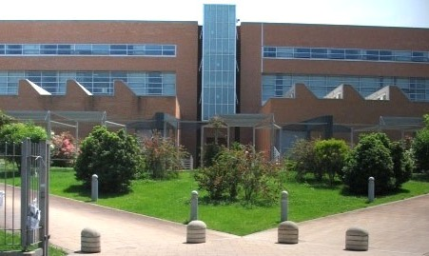
Thank you!

Slide 44
Mutual Benefits of the Anticipated Participation of Non-COST members
University of Queensland, Dept. of Transport and Main Roads (Australia)
Benefits for COST and for the COST Action:
Access to >10 years of TMR experience using impulse, stepped freq. and noise-modulated GPR (NM-GPR) technologies for real-life road and bridge investigations;
Current TMR research developing GPR velocity calibration methods; in-situ moisture quantification techn.; and work combining highway speed 3D NM-GPR data with data from Traffic Speed Deflectometer and other techniques for pavement investigations.
Benefits for Queensland Department of Main Roads, Australia:
Access to the latest European & worldwide GPR research;
Opportunity to broaden technical networks, improve experience and investigation techniques & highlight TMR research.
Targeted scientific activities, including WGs selected for cooperation:
WG2: Use of GPR for civil engineering, with a focus on investigating roads and bridges
WG4: Applications of GPR + NDT, with a focus on roads and bridges

Slide 45
U.S. Experts
Dr. Waheed Uddin, PE Professor of Civil Engineering & Director CAIT University of Mississippi
University, MS 38677-1848, USA
Phone: 1-662-915-5363
http://www.olemiss.edu/projects/cait/ncitec/ cvuddin@gmail.com Blog: http://infrastructureglobal.com/
Dr. Uddin has many years of research and teaching experience in materials, condition monitoring, and nondestructive evaluation of infrastructure including deflection testing, thermography, LIDAR, multispectral satellite imagery analysis, and GPR. He is currently Associate Director of Research, USDOT’s National Center of Intermodal Transportation for Economic Competitiveness (NCITEC).

Slide 46
U.S. Experts
Dr. A.T. Papagiannakis, PE, F.ASCE
R.F. McDermott Professor and Chair
Dept. of Civil & Environmental Eng.
University of Texas - San Antonio
San Antonio, TX 78249, USA
Dr. Papagiannakis has many years of research and teaching experience in construction materials, life cycle costing, pavement condition monitoring, and nondestructive evaluation of infrastructure.
AT.Papagiannakis@utsa.edu
Dr. Luhr has many years of industry, research, and teaching experience in construction materials, pavement management services, performance modeling, condition monitoring and nondestructive evaluation of infrastructure. Formerly, he was a university professor, CEO of a consulting company, and research manager with Portland Cement Association.
Dr. David R. Luhr, PE
State Pavement Management Engineer
Washington State Department of Transportation
PO Box 47365,
Olympia, WA 98504-7365, USA Phone: 1-360-709-5405
LuhrD@wsdot.wa.gov

Slide 47
U.S. Experts
Dr. John P. Zaniewski, PE Asphalt Technology Professor
Director, Harley O. Staggers National
Transportation Center
PO Box 6103 West Virginia University Morgantown WV 26506-6103, USA Phone: 1-304-293-9955
http://www.cemr.wvu.edu/~wwwasph/
John.Zaniewski@mail.wvu.edu
Dr. Zaniewski is a senior professor and researcher wit prior years of industry experience in construction materials, pavement management services, performance modeling, pavement condition monitoring and nondestructive evaluation.

Slide 48
U.S. Experts
Dr. Parmar is an electrical engineering professor and experienced researcher in bridge condition monitoring and nondestructive evaluation. He is an expert in using acoustic and ultrasonic sensors for structural assessment of infrastructure.
Dr. Devendra Parmar
Professor, Department of Electrical Eng.
Hampton University
Hampton, VA 23668, USA
Phone: 1-757-728-6874
Devendra.Parmar@Hamptonu.Edu
Dr. Rafiqul A. Tarefder, PE Associate Professor and Regent's Lecturer: Department of Civil Engineering, MSC01 1070 1 University of New Mexico Albuquerque, New Mexico 87113, USA Phone: 1-505-277-6083
Dr. Tarefder has several years of teaching and research experience in construction materials and pavement performance modeling. In recent years he has done outstanding research in nano material characterization of paving asphalt materials in NSF-funded projects.
tarefder@unm.edu

Slide 49
U.S. Experts
Dr. Paul M. Goggans
Professor of Electrical Engineering
University of Mississippi
Department of Electrical Engineering
Anderson Hall Room 302
University, MS 38677-1848, USA
Phone: 1-662-915-5954
goggans@olemiss.edu
Dr. Goggans is an electrical engineering professor with extensive teaching and research experience in radar signal processing, electromagnetic, and antennas. He had prior experience in radar working for Los Alamos National Lab. His GPR knowledge is related to his interest in landmine and unexploded ordinance detection.

Slide 50
More about Scientific Workplan
Year 1
Collection and sharing of information about state-of-the-art, ongoing studies and open problems, in the field of CE applications of GPR
Definition and coordination of test scenarios, representing both typical and unusual situations that may occur in CE applications, for an advanced comparison of available GPR equipment, inspection techniques, EM methods and data-processing algorithms, to be performed during the next year of activity.
Creation of end-user database (to be always integrated as new expressions of interests will come).
Set-up of an advanced communication system, for partnership integration and dissemination of results. Set-up of the Action website (to be always kept up-to-date).
Short-Term Scientific Missions

Slide 51
Among the Action’s partners, there is one of the leading manufacturers of GPR products. They are designed, fabricated and commercialized by this Company through a wide distributor network, currently including more than 40 representatives. From a geographically point of view the main market of the Company are Europe (in particular Italy, Spain, France, Germany, Poland), Far East, North and South America.
The Company has already been involved in a number of research projects for the improvement of GPR equipment and for the use of GPR technologies for road diagnostics, humanitarian demining, pipe detection and archaeology applications.
It is involved in FP7 current projects NETTUN and TIRAMISU. The outcome of such research projects have been exploited with the development of new products.
The Company is willing and capable to be involved in the COST Action activities because of its
technical skill in product development and production engineering
manufacturing, sales and after-sale support organisation
marketing organisation.

Slide 52
More about Scientific Workplan
Year 2
Multidisciplinary and multinational application and comparison of GPR equipment, inspection practice, EM and data-processing algorithms.
Strong human exchange and sharing of resources: numerous Short-Term Scientific Missions.
Year 3
Outline and test of innovative inspection procedures, on the basis of the activity carried out during the previous years.
Codification and development of new EM algorithms and of new methods for an effective data-processing with accurate estimation of geometrical and geophysical parameters.
Assessment for the design of novel GPR equipment and prototype realization.
Short-Term Scientific Missions

Slide 53
More about Scientific Workplan
Year 4
Critical study and review of results obtained during preceding years.
Coordination and elaboration of a handbook with protocols and guidelines at EU level.
Optimization of the new EM and data-processing codes. Realization of graphical user interface and manuals. Releasing freeware software for the benefit of GPR community.
Test and optimization of the new GPR equipment.
Short-Term Scientific Missions.

Slide 54
More about WG1
Will focus on the design of innovative GPR equipment for CE applications, on the building of prototypes and on the testing and optimization of the new system.
Synergy with WG2 and WG4 will for a deep understanding of problems, merits and limits of currently available GPR equipment. This will help in selecting the working parameters for the new GPR, according to the application’s requirements.
The architecture of the novel system will assume the use of an array of antennas, operating simultaneously and lined up in the transverse direction with respect to the direction of movement → faster data collection, clear images, improved detection probability of sought targets, possibility to survey the site with a regular grid and use of advanced data-processing methods → interaction with WG3.
In cooperation with the WG3, the possibility of designing a beamforming network for the transmitting antennas will be studied, in order to develop an equipment able to focus the EM waves at specific depths and at focal areas of specified size, according to the needs of the various CE applications.
Furthermore, it will be necessary to interact with the WG2 also for the development of advanced calibration measurement procedures as well as to test and optimize the fabricated prototypes in laboratory experiments and in real case studies.

Slide 55
More about WG2
Will focus on the surveying, through the use of a GPR system, of pavement, bridges, tunnels and buildings, as well as on the sensing of underground utilities and voids.
Initially, information will be collected and shared about state-of-the-art, ongoing studies, problems and future research needs, in the application of GPR to the above-mentioned CE applications.
Test scenarios will be defined, representing both typical and unusual situations that may occur in the various CE tasks, for an advanced comparison of available inspection procedures (taking advantages of the interaction with the WG4), GPR equipment (interacting with the WG1), application of EM forward-scattering simulators and data-processing algorithms (thanks to the cooperation with the WG3).
The available equipment, inspection procedures and algorithms will be applied to the test scenarios as a joint effort of the WG1, WG2 and WG3. On the basis of these studies, innovative inspection procedures will be outlined in the WG2 for the inspection of pavement, bridges, tunnels and buildings and for the detection of underground utilities and voids. The new procedures will be tested through laboratory experiments and in real scenarios, in synergy with the WG1 and the WG3. A deep analysis and critical review of the obtained results will lead, at the end of the Action lifetime, to the development of a handbook with protocols and guidelines at EU level.

